Slide 1
Behavioral Observation Through Image Processing
Dulanja Wijethunga
Dinidu Bathiya
Sasith Weranja

Slide 2
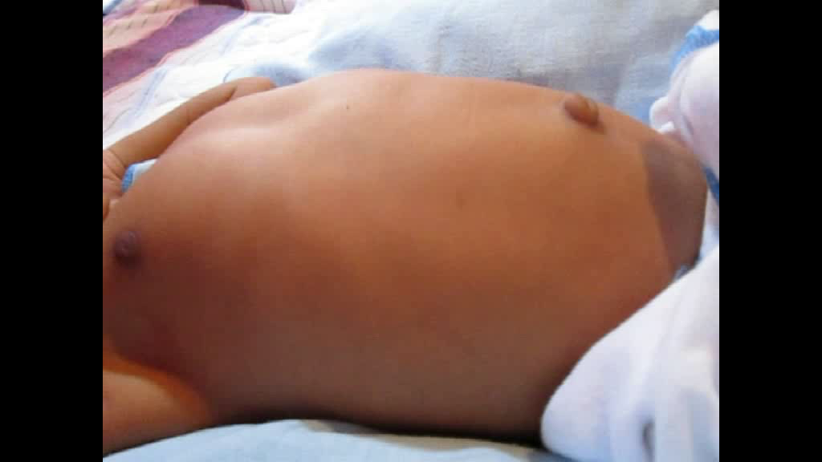
Introduction
Observe this video carefully
Many breathing pattern abnormalities do not happen very frequently.
It requires thorough observation for very long time.
Notes:
The final product is a application with client side and server side with data minining capabilities

Slide 3
Objectives
Identify those abnormalities and help doctors to do accurate diagnostic.
Predict health issues which can arise in future.
A method to store video records of the patient.
Collect a huge amount of data of breathing patterns to be used for further analyzing and research.

Slide 4
What other people have done
BELLINI and AKULLIAN have done a research on Video Self-Modeling involvements for people with Autism Spectrum Disorders
ARROYO, JAVIER and BERGASA have implemented a real-time surveillance system to detect suspicious behaviors in shopping malls.
DONGMIN GUO, VEN and ZHOU recently used optical flow method to track and measure blood cells motion in a human body.
Notes:
For Bellini and Akullian
In this study, researchers had revealed that communication and functional skills can be enhanced using video modeling.

Slide 5
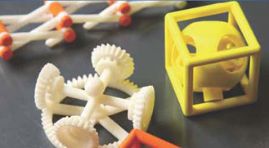

Methodology and Results
Research and Prototyping
System Implementation

Slide 6

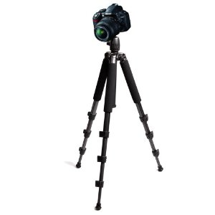
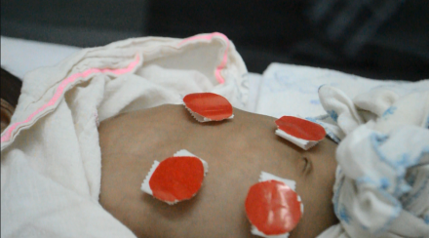
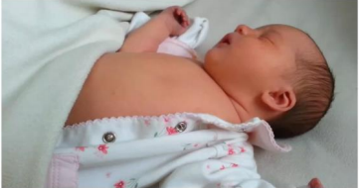
Methodology and Results
Research and Prototyping
Data Collecting
Motion Analysis
Method Comparison
Noise Reduction
Pattern Identification

Slide 7
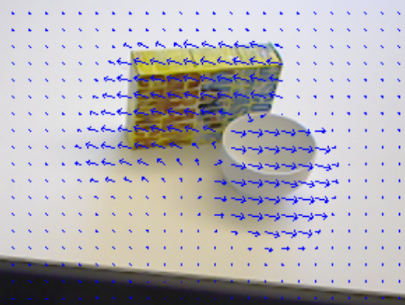
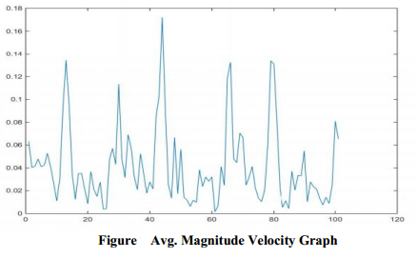
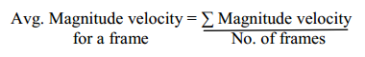
Methodology and Results
Optical Flow Algorithm
Image Subtraction
Research and Prototyping
Data Collecting
Motion Analysis
Method Comparison
Noise Reduction
Pattern Identification

Slide 8
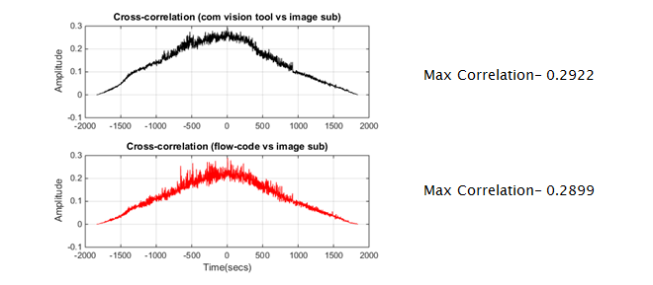
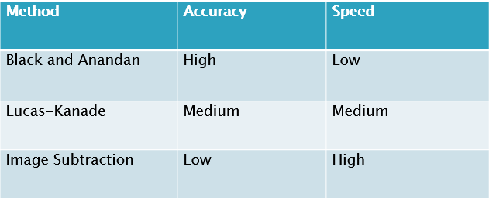
Methodology and Results
Optical Flow Algorithm
Black and Anandan dense
Lucas-Kanade
Image Subtraction
Research and Prototyping
Data Collecting
Motion Analysis
Method Comparison
Noise Reduction
Pattern Identification
Cross Correlation

Slide 9
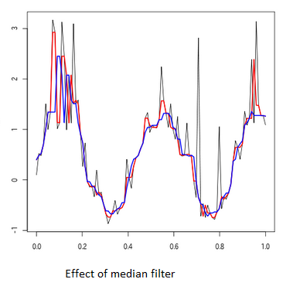
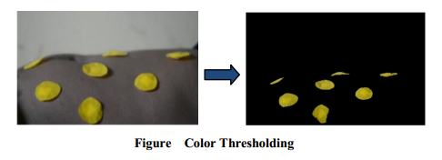
Methodology and Results
Research and Prototyping
Data Collecting
Motion Analysis
Method Comparison
Noise Reduction
Pattern Identification

Slide 10
Methodology and Results
Research and Prototyping
Data Collecting
Motion Analysis
Method Comparison
Noise Reduction
Pattern Identification

Slide 11
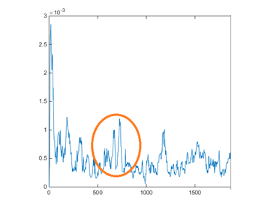
Methodology and Results
Research and Prototyping

Slide 12
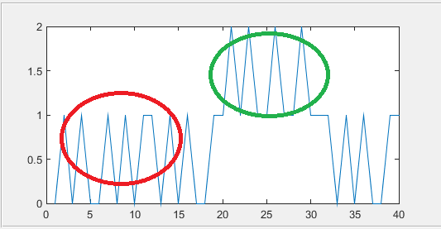
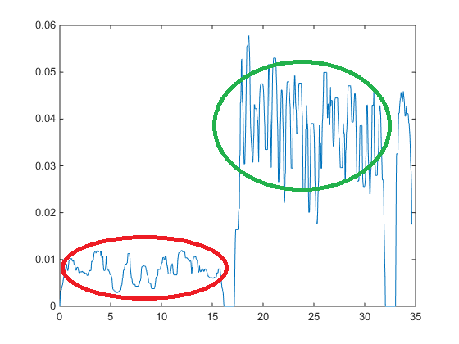
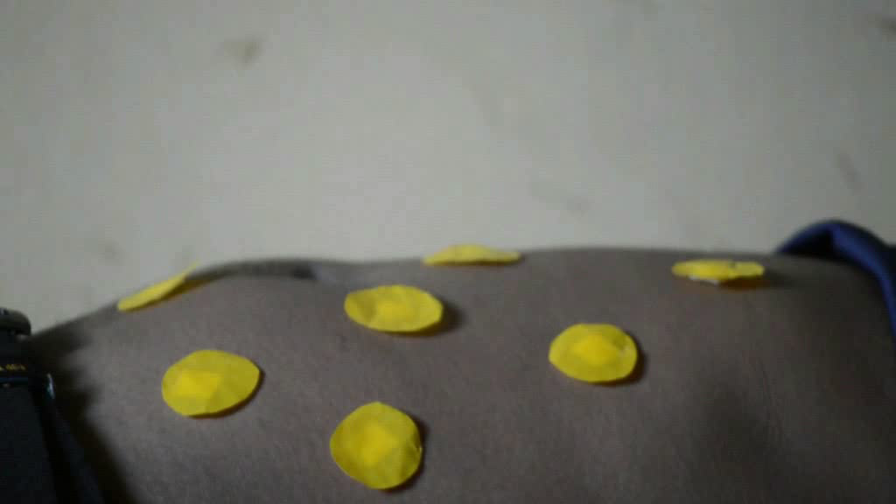
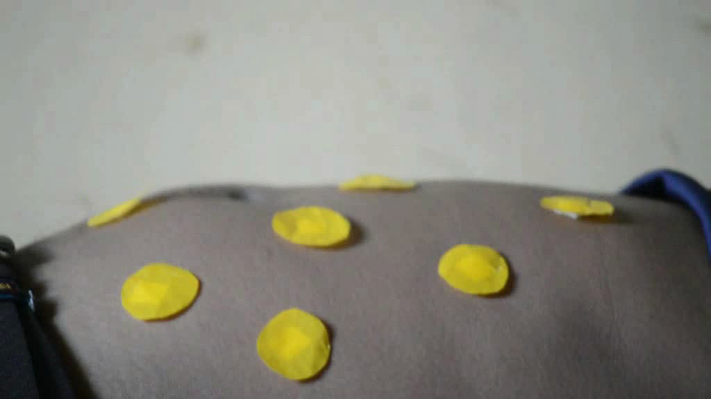
Methodology and Results
Research and Prototyping

Slide 13
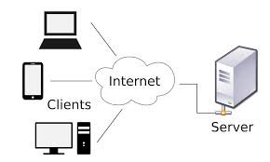
Methodology and Results
System Implementation
Client Server Architecture
Motion History implementation
Optical Flow implementation
Machine Learning Analysis

Slide 14
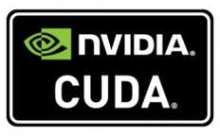

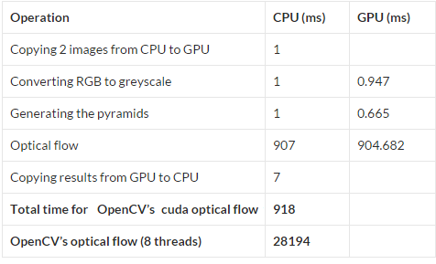
Methodology and Results
GPU version is about 30x faster
Optical Flow Algorithm takes time
System Implementation
Client Server Architecture
Optical Flow implementation
Motion History implementation
Machine Learning Analysis

Slide 15
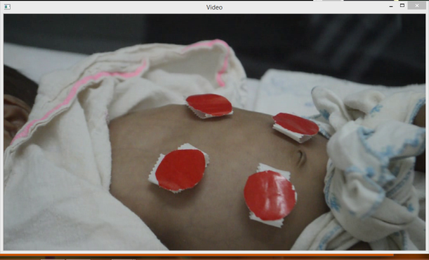
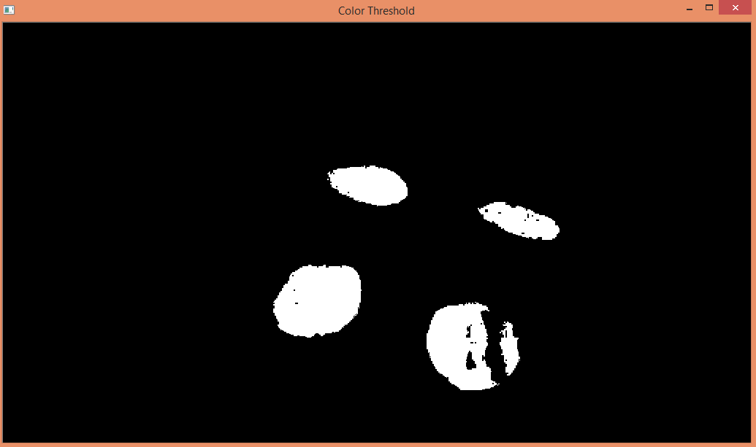
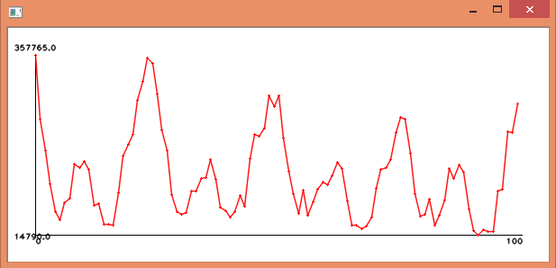
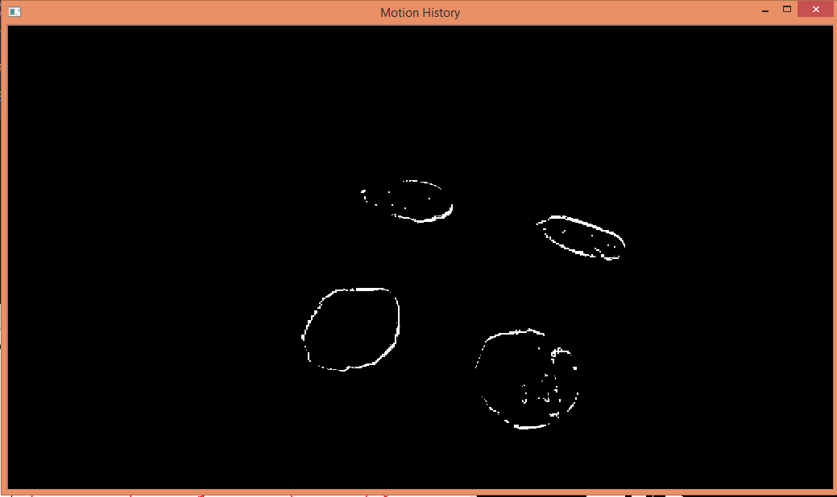
Methodology and Results
System Implementation
Client Server Architecture
Optical Flow implementation
Motion History implementation
Machine Learning Analysis

Slide 16
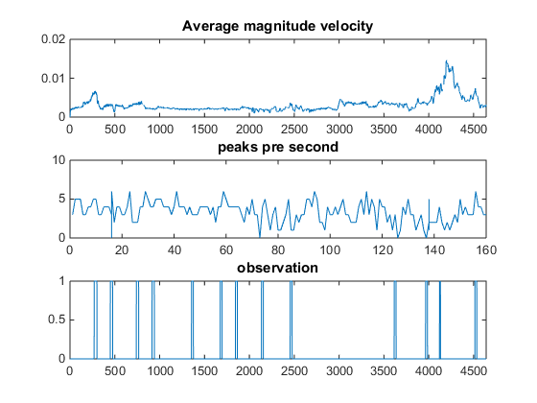
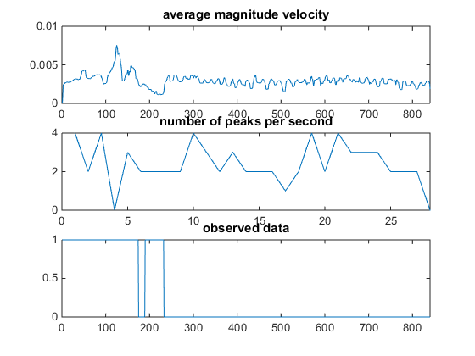
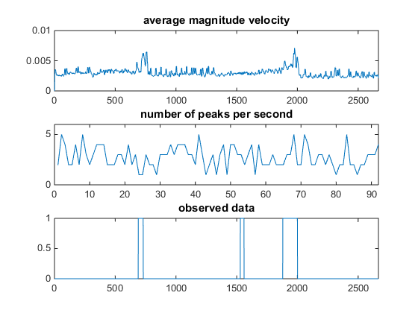
Methodology and Results
System Implementation
Client Server Architecture
Optical Flow implementation
Motion History implementation
Machine Learning Analysis
FUTURE WORK

Slide 17
THANK YOU !

